Slide 1
Eu environmental pollutants
Principal component analysis
Evangjeli Suku

Slide 2
Principal Component Analysis (PCA)
PCA (Principal Component Analysis) is a dimensionality‑reduction method. It creates uncorrelated linear combinations of the original variables, while retaining most of the original variance.
For this analysis here are the steps that we will follow:
Check correlation among variables
Computation of eigenvalues
How many principal components do we keep? (Kaiser criterion, Scree Plot)
Cos2, contribution and coordinates
Barchar of cos2 and variable contribution for PC1 and PC2
Correlation Plot
Biplot (observations-variables)

Slide 3
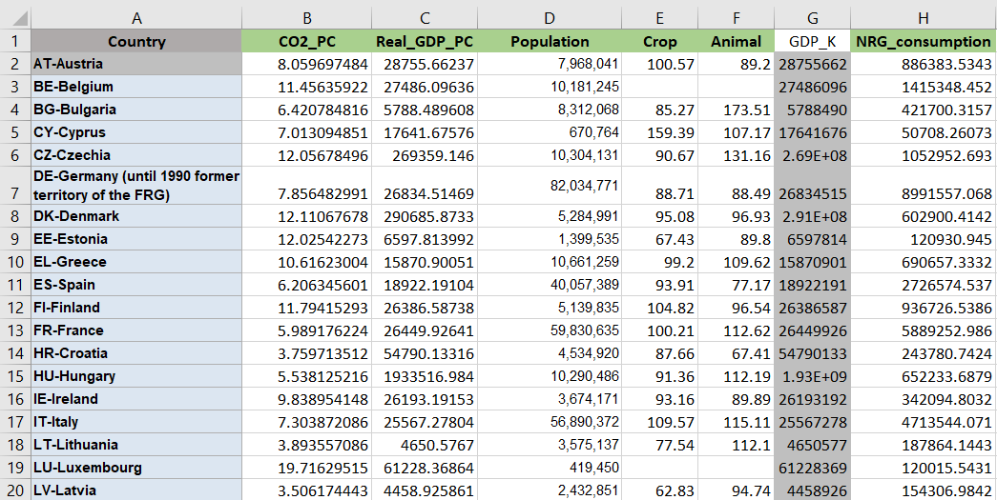
About this dataset: 28 EU member countries, years: 1995-2015, 8 variables, 308 observations.

Slide 4
Correlatioin matrix
> cor(environment)
 | CO2_PC | Real_GDP _PC | Population | Crop | Animal | GDP_K | NRG _consumption
CO2_PC | 1.00000000 | -0.08880114 | -0.16869977 | NA | NA | -0.08880114 | -0.10126399
Real_GDP _PC | -0.08880114 | 1.00000000 | -0.09110975 | NA | NA | 1.00000000 | -0.11247201
Population | -0.16869977 | -0.09110975 | 1.00000000 | NA | NA | -0.09110975 | 0.97419868
Crop | NA | NA | NA | 1.000 | NA | NA | NA
Animal | NA | NA | NA | NA | 1.000000 | NA | NA
GDP_K | -0.08880114 | 1.00000000 | -0.09110975 | NA | NA | 1.00000000 | -0.1124720
NRG _consumption | -0.10126399 | -0.11247201 | 0.97419868 | NA | NA | -0.1124720 | 1.00000000

Slide 5
eigenvalue | Variance | comulative var
> eig.val
 | eigenvalue | variance.percent | cumulative.variance.percent
Dim.1 | 2.244875 | 32.06964 | 32.06964
Dim.2 | 1.846508 | 26.37869 | 58.44833
Dim.3 | 1.212152 | 17.31646 | 75.76479
Dim.4 | 1.056209 | 15.08870 | 90.85349
Dim.5 | 0.6179292 | 8.827560 | 99.68105
Dim.6 | 0.02232631 | 0.3189473 | 100
Dim.7 | 1.962440e-32 | 2.803486e-31 | 100
Με βάση το Κριτήριο του Kaiser κρατάμε τις 4 πρώτες κύριες συνιστώσες.

Slide 6
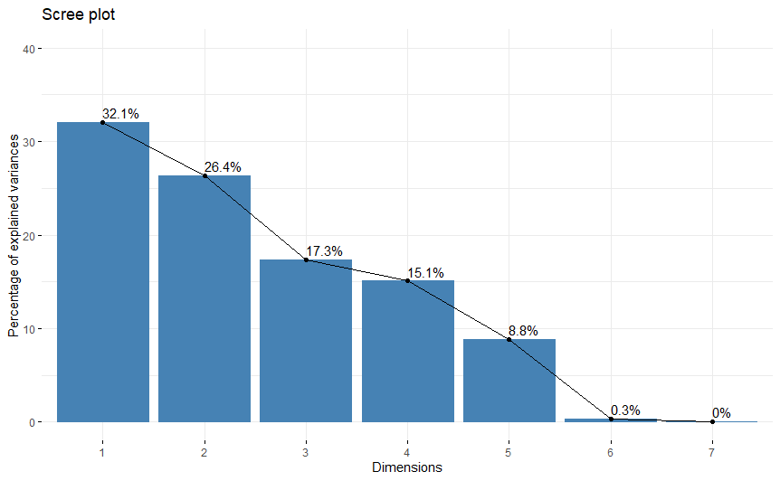
Scree Plot
> fviz_eig(res.pca, addlabels = TRUE, ylim = c(0, 40))
If we stick with the first 5 PCs, those will be able to interpret around 99.7% of the overall original variance.

Slide 7
cos2 : Representation of the variables
> var$cos2
 | Dim.1 | Dim.2 | Dim.3 | Dim.4 | Dim.5
CO2_PC | 0.00002390662 | 0.1174659888 | 0.5867717182 | 0.0434363293 | 0.2522355164
Real_GDP_PC | 0.5236544 | 0.4466731055 | 0.0285137443 | 0.0008886259 | 0.0002694059
Population | 0.5443880 | 0.4336837634 | 0.0001414212 | 0.0008186315 | 0.0096690434
Crop | 0.03873184 | 0.0009990264 | 0.5210026870 | 0.2360088869 | 0.2032573956
Animal | 0.05109650 | 0.0060480282 | 0.0440196897 | 0.7713719729 | 0.1274394701
GDP_K | 0.5236544 | 0.4466731055 | 0.0285137443 | 0.0008886259 | 0.0002694059
NRG_consumption | 0.5633257 | 0.3949650894 | 0.0031894781 | 0.0027960138 | 0.0247889542

Slide 8
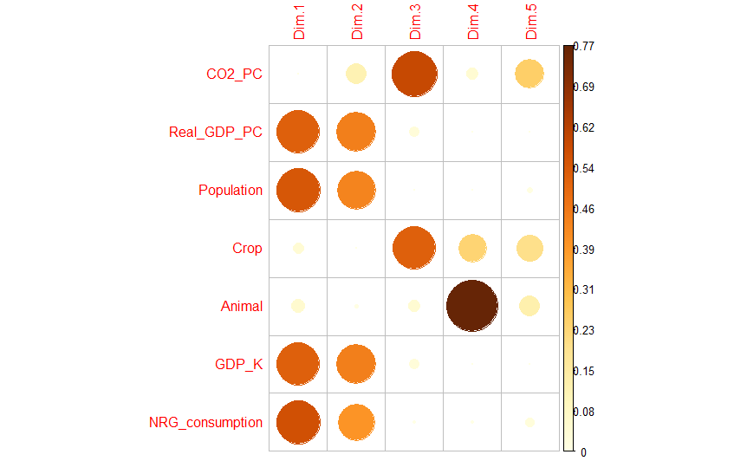
> corrplot(var$cos2, is.corr=FALSE)
The bigger and bolder the color is, the more significant the variable in that Principal Component is.
NRG_consumption, Population, Real_GDP_PC, GDP_K are represented at a higher rate in the first and second principal components.
CO2_PC and Crop play a significant role in PC3.
The fourth principal component mostly concerns the variable Animal.

Slide 9
Συνεισφορά/contribution (%) των μεταβλητών στις PCs
> var$contrib
Contribution (%) of Variables
 | Dim.1 | Dim.2 | Dim.3 | Dim.4 | Dim.5
CO2_PC | 0.001064942 | 6.36152034 | 48.40741792 | 4.11247450 | 40.81948545
Real_GDP_PC | 23.326664571 | 24.19015133 | 2.35232322 | 0.08413352 | 0.04359818
Population | 24.250260463 | 23.48669696 | 0.01166695 | 0.07750658 | 1.56474942
Crop | 1.725345338 | 0.05410355 | 42.98161283 | 22.34490216 | 32.89331503
Animal | 2.276140172 | 0.32753867 | 3.63153071 | 73.03212811 | 20.62363647
GDP_K | 23.326664571 | 24.19015133 | 2.35232322 | 0.08413352 | 0.04359818
NRG _consumption | 25.093859943 | 21.38983782 | 0.26312515 | 0.26472162 | 4.01161727

Slide 10
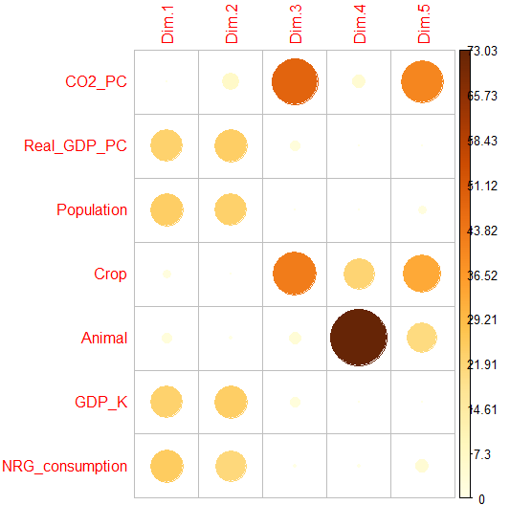
> corrplot(var$contrib, is.corr=FALSE)
The plot shows the contribution of each variable to the top 5 principal components
The variables Real_GDP_PC, Population, GDP_K, NRG_consumption contribute the most to the dimensions 1 and 2.
CO2_PC contributes more to dimension 3 and 5.
Crop contributes to dimensions 3, 4 and 5.
Animal contributes more to PC4 and less to PC5.

Slide 11
Coordinates of variables
> var$coord
 | Dim.1 | Dim.2 | Dim.3 | Dim.4 | Dim.5
CO2_PC | 0.00488944 | -0.34273312 | 0.76601026 | -0.20841384 | 0.50223054
Real_GDP_PC | -0.72363970 | 0.66833607 | 0.16886013 | -0.02980983 | 0.01641359
Population | 0.73782653 | 0.65854671 | 0.01189206 | 0.02861174 | 0.09833129
Crop | 0.19680407 | -0.03160738 | 0.72180516 | 0.48580746 | -0.45084077
Animal | -0.22604534 | -0.07776907 | -0.20980870 | 0.87827784 | 0.35698665
GDP_K | -0.72363970 | 0.66833607 | 0.16886013 | -0.02980983 | 0.01641359
NRG _consumption | 0.75055029 | 0.62846248 | 0.05647546 | 0.05287735 | 0.15744508

Slide 12
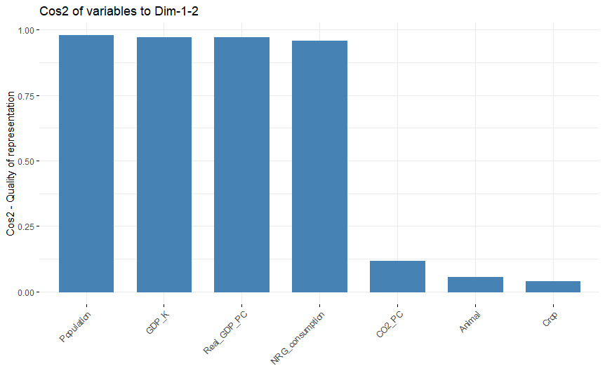
Total cos2 of the first two dimensions
> fviz_cos2(res.pca, choice = "var", axes = 1:2)

Slide 13
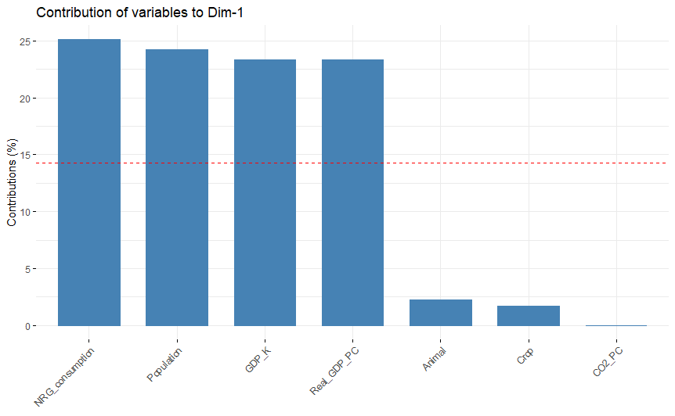
Contribution of the variables to PC1
> fviz_contrib(res.pca, choice = "var", axes = 1, top = 10)
Average expected contribution

Slide 14
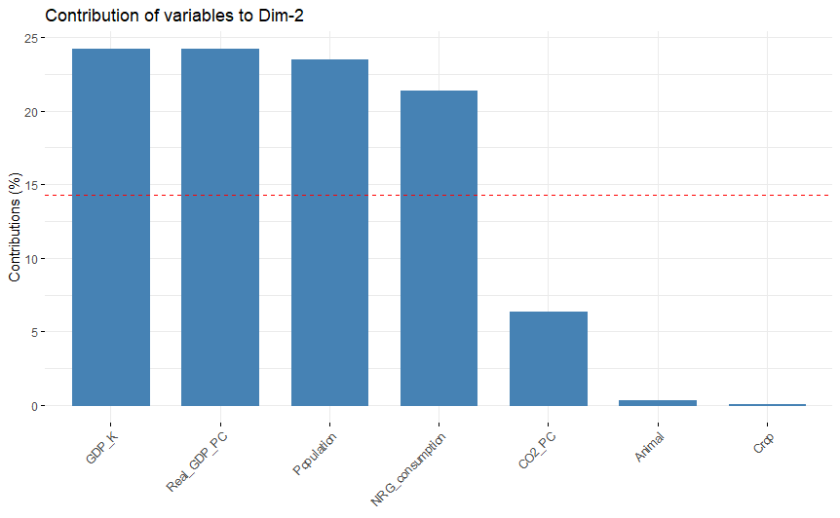
Contribution of variables to PC2
> fviz_contrib(res.pca, choice = "var", axes = 2, top = 10)

Slide 15
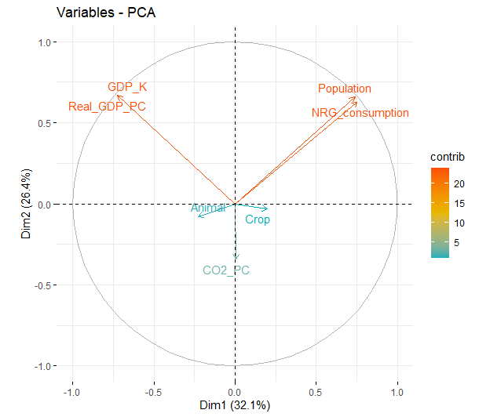
correlation circle
> fviz_pca_var(res.pca, col.var = "contrib", # Color by contributions to the PC gradient.cols = c("#00AFBB", "#E7B800", "#FC4E07"), repel = TRUE)
GDP_K, Real_GDP_PC, Population, NRG_consumption contribute the most on the first two principal components.
Population and NRG_consumption are positively correlated.
CO2_PC, Animal, Crop are closer to the center of the graph, meaning their contribution is weaker.
Variables GDP_K, Real_GDP_PC show a weak relationship/ low correlation with Population.

Slide 16
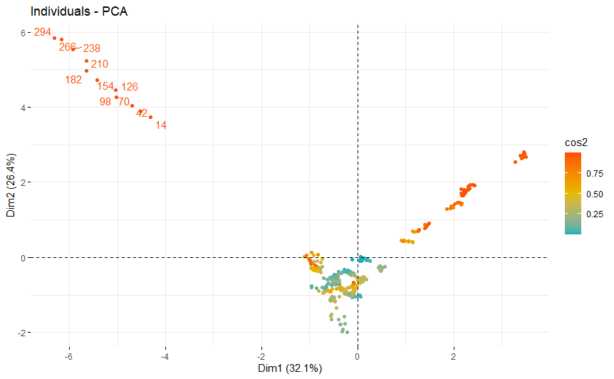
Graph of individuals
> fviz_pca_ind(res.pca, col.ind = "cos2", # Color by the quality of representation gradient.cols = c("#00AFBB", "#E7B800", "#FC4E07"), repel = TRUE)
Individuals with a similar profile are grouped together.
HUNGARY

Slide 17
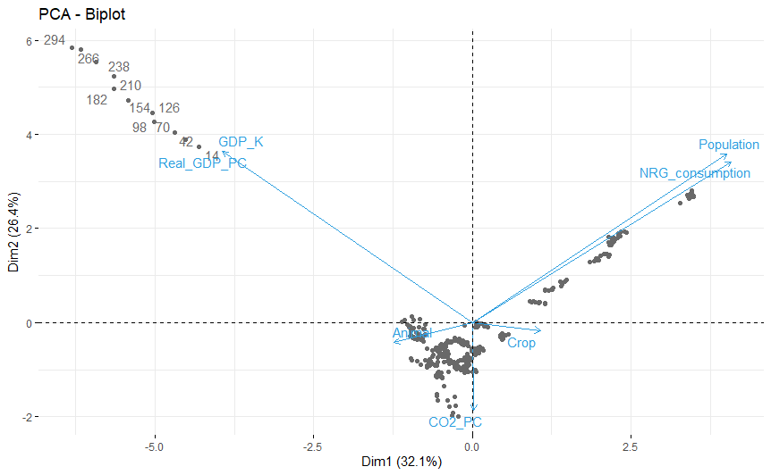
Biplot of individuals and variables
> fviz_pca_biplot(res.pca, repel = TRUE, col.var = "#2E9FDF", # Variables color col.ind = "#696969" # Individuals color)

Slide 18
βΙΒλιογραφια
PCA - Principal Component Analysis Essentials - Articles – STHDA
Principal Component Analysis in R: prcomp vs princomp - Articles – STHDA
Δημήτριος Καρλής - Πολυμεταβλητή Στατιστική Ανάλυση (2003).pdf (uoa.gr)
Dziadek, B., Iskra, J., Przednowek, K. (2018). Principal Component Analysis in the Study of Structure of the Best Polish Decathlon Competitors from the Period between 1985 –2015. Central European Journal of Spor t Sciences and Medicine, 3 (23), 77–87. DOI: 10.18276/cej.2018.3-08
Principal component analysis (utdallas.edu)

Slide 19

The End

